Slide 1
Introduction to Deep Neural Networks

Slide 2
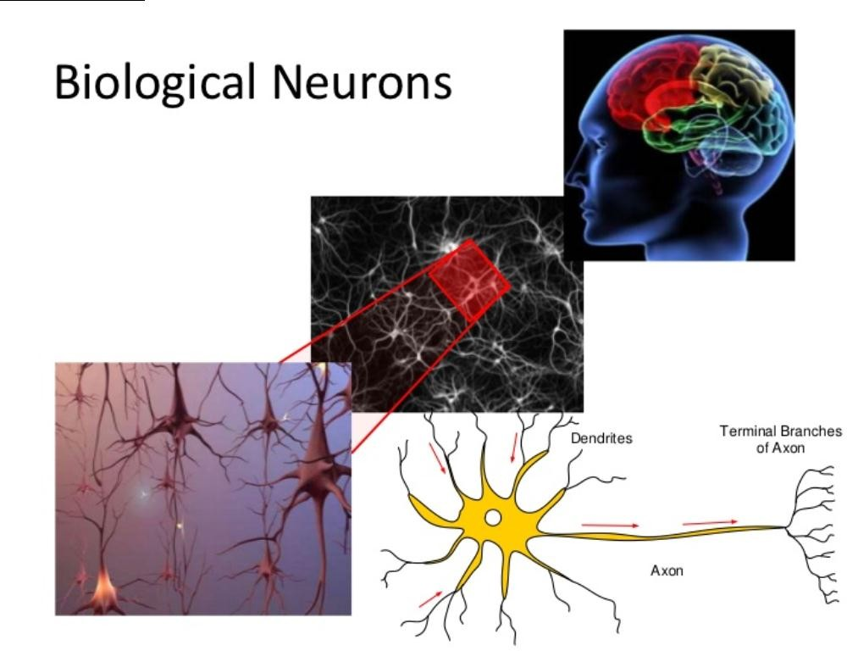

Slide 3
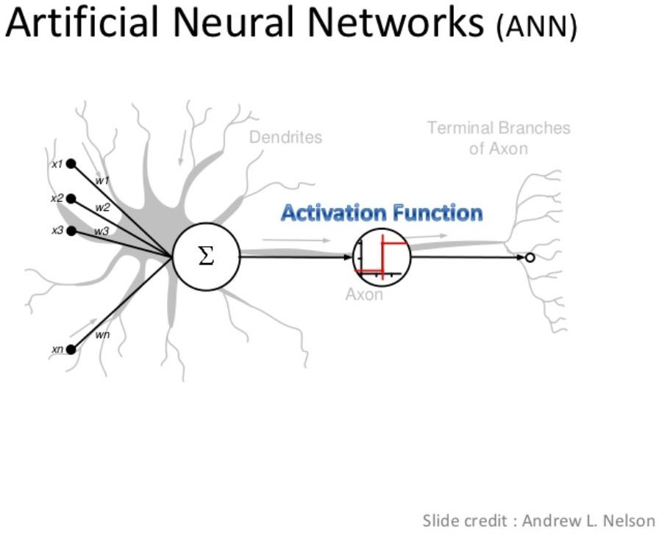

Slide 4
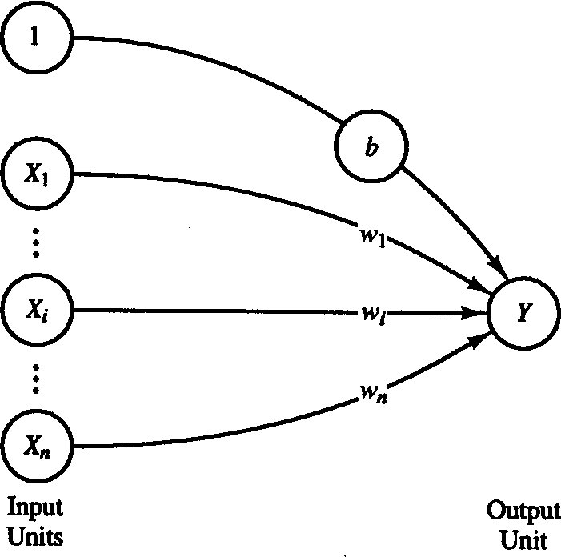
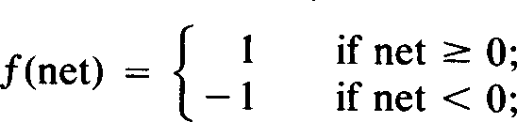
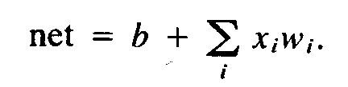
Single Layer Perceptron for Pattern Classification
Architecture
Thus the Neuron fires if
net = b +
∑ i i
T
x w = w x + b ≥ 0
i
w^{T} x ≥ −b
Discrimination Hyper
plane
Thus –b can be thought of as a threshold which when exceeded would cause the neuron to fire
To Answer: Why have a bias or threshold?
5

Slide 5
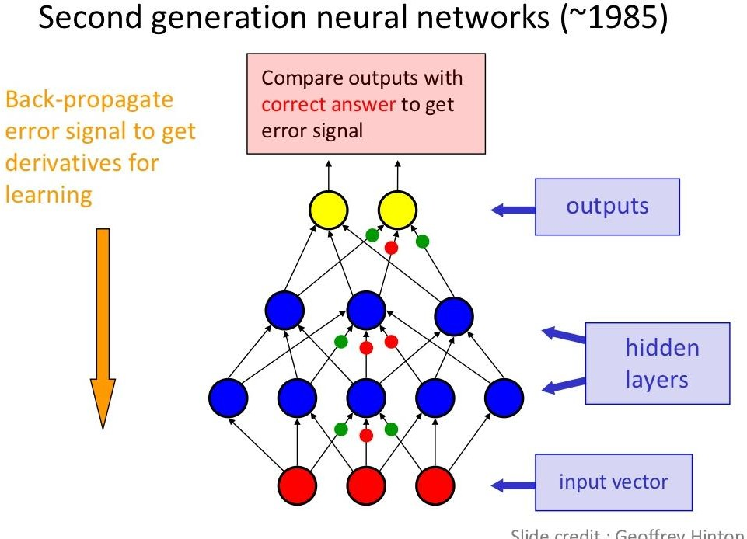
6

Slide 6
Back Propogation
Advantages
Multi layer networks trained by back propogation algorithm allow any mapping between input and output
What is wrong with back propogation?
Requires labeled training data
Almost all data is unlabeled
Learning time does not scale well
Very slow with multiple hidden layers
Vanishing gradients
Overfitting
In 90’s,one of the important reasons of Backpropagators not providing satisfactory results on complicated problems was that hardware for processing was not that advanced as it is today.
7

Slide 7
But Still We need Deep Neural Networks
7

Slide 8
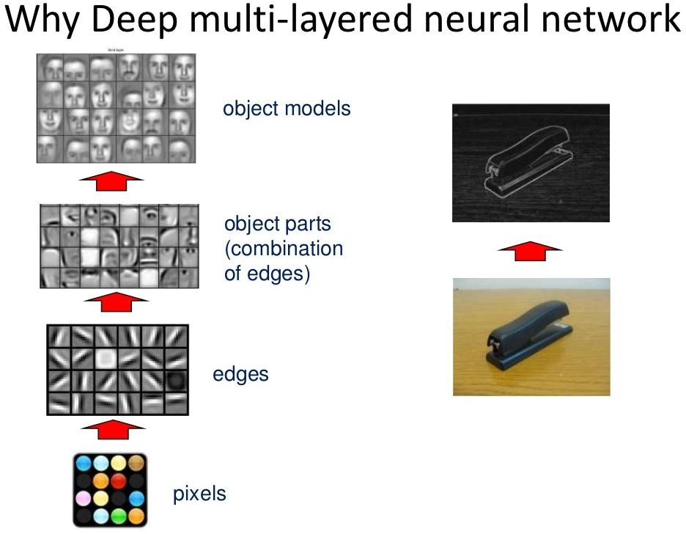
8

Slide 9
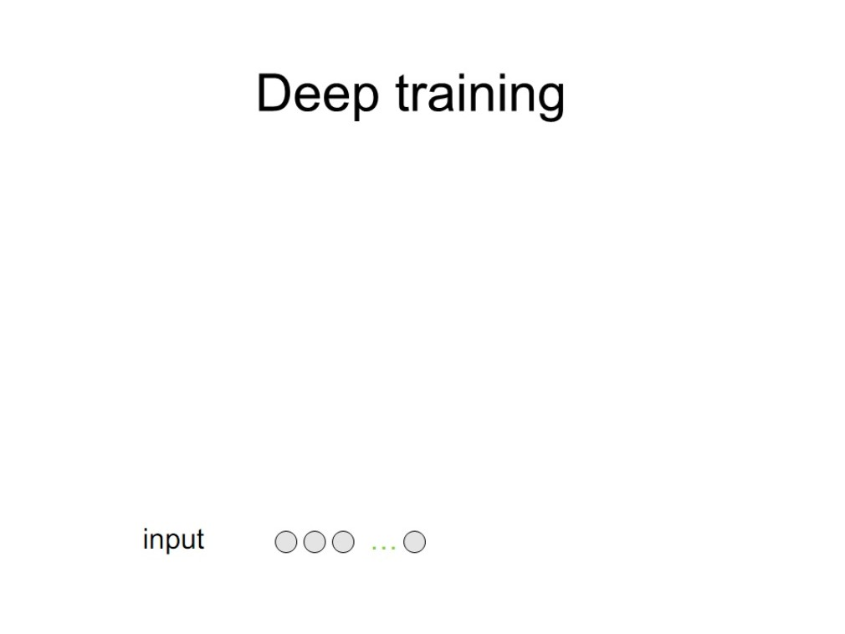

Slide 10
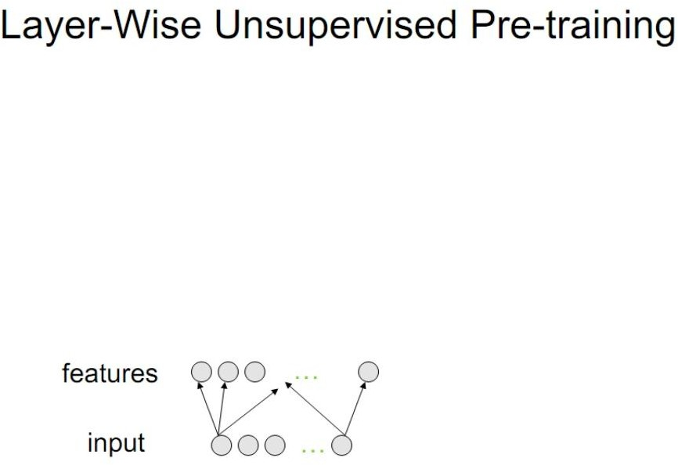

Slide 11
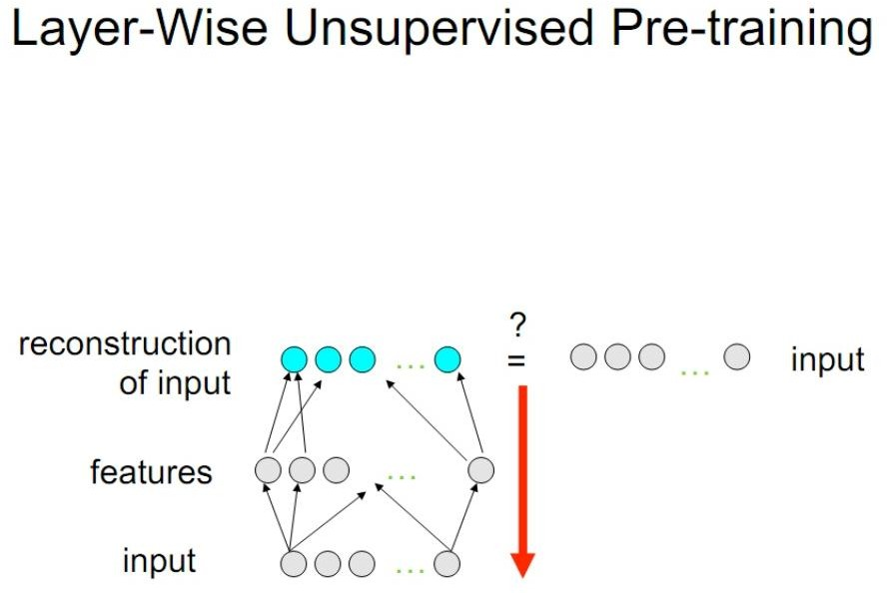

Slide 13
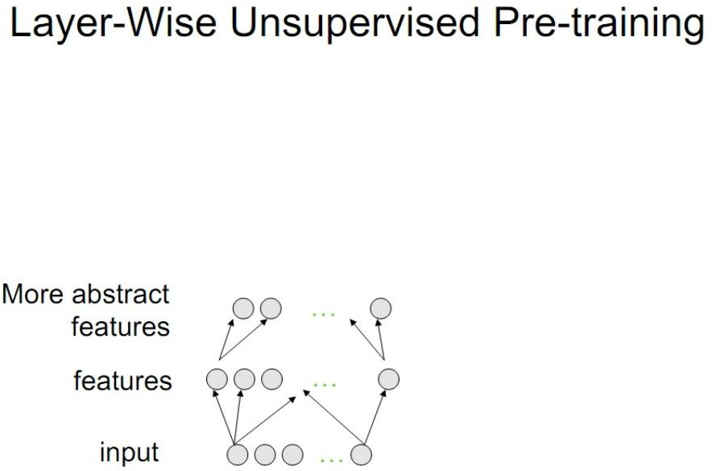

Slide 14
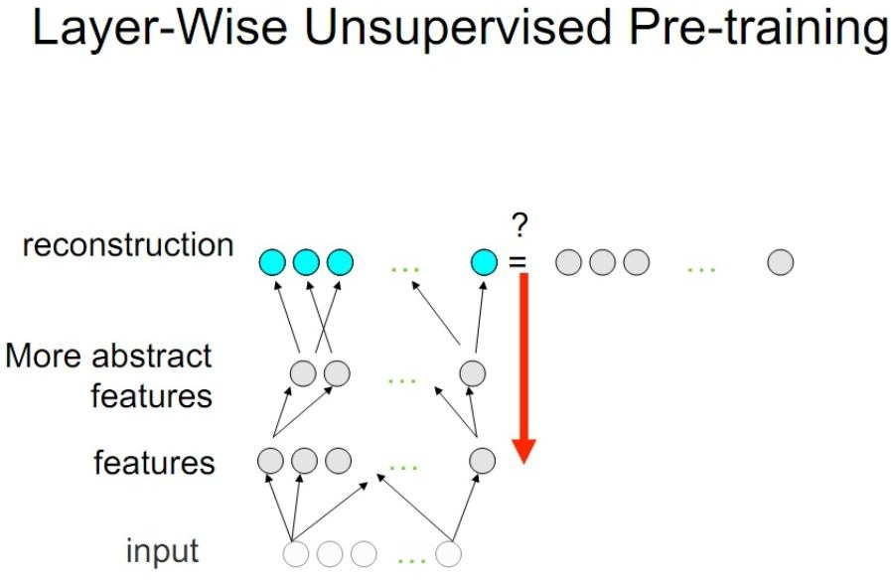

Slide 16
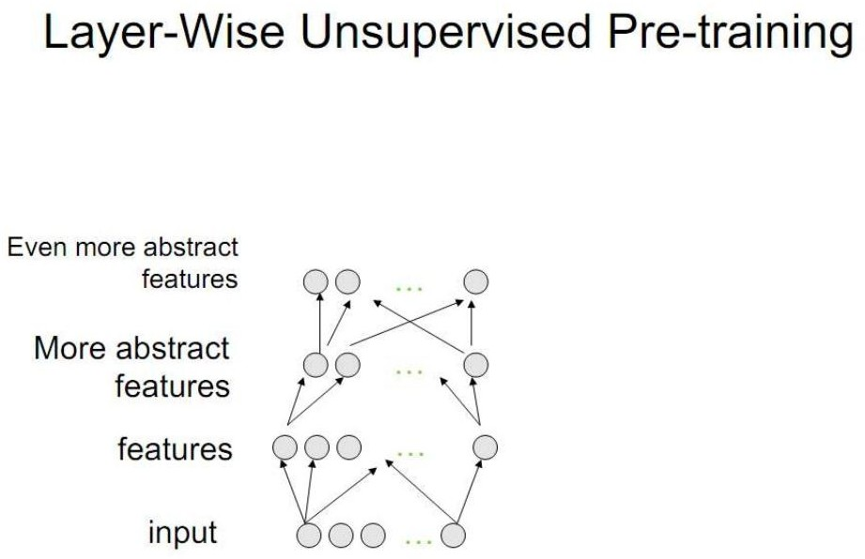

Slide 17
